Slide 1

Movement and Control of
Biomimetic Humanoid Robots
Dissertation Defense
Ben P. Bolen
Advisor: M. Anthony Hunt, Ph.D.
Agile & Adaptive Robotics Laboratory · Portland State University · September 2026
Notes:
Good morning. Committee members, thank you for reading the dissertation. Today: can pneumatic artificial muscles be characterized and arranged so a biomimetic robot reproduces human joint force capability - and how the controller will be built on top.

Slide 2
ROADMAP
Three questions connect one actuator to a walking, neurally controlled robot
01
02
03
What force can one
actuator produce?
What torque can a
BPA-driven knee produce?
How will the robot
be controlled?
Isometric characterization of Festo BPAs:
resting length, pressure, contraction
Pinned + biomimetic knees; correction
terms identified by multiobjective fit
OpenSim to MuJoCo pipeline; two-layer
spinal CPG with full proprioception
537 tests · dimensionless force surface
meets / exceeds human torque over
most of range of motion
rhythm verified · closed loop next
Dissertation Ch. 3-6; Bolen et al. 2026, Actuators; Bolen et al., in preparation 2025
2
Notes:
One sentence per aim. Aim 1 published; Aim 2 in manuscript form; Aim 3 is the defined path.

Slide 3
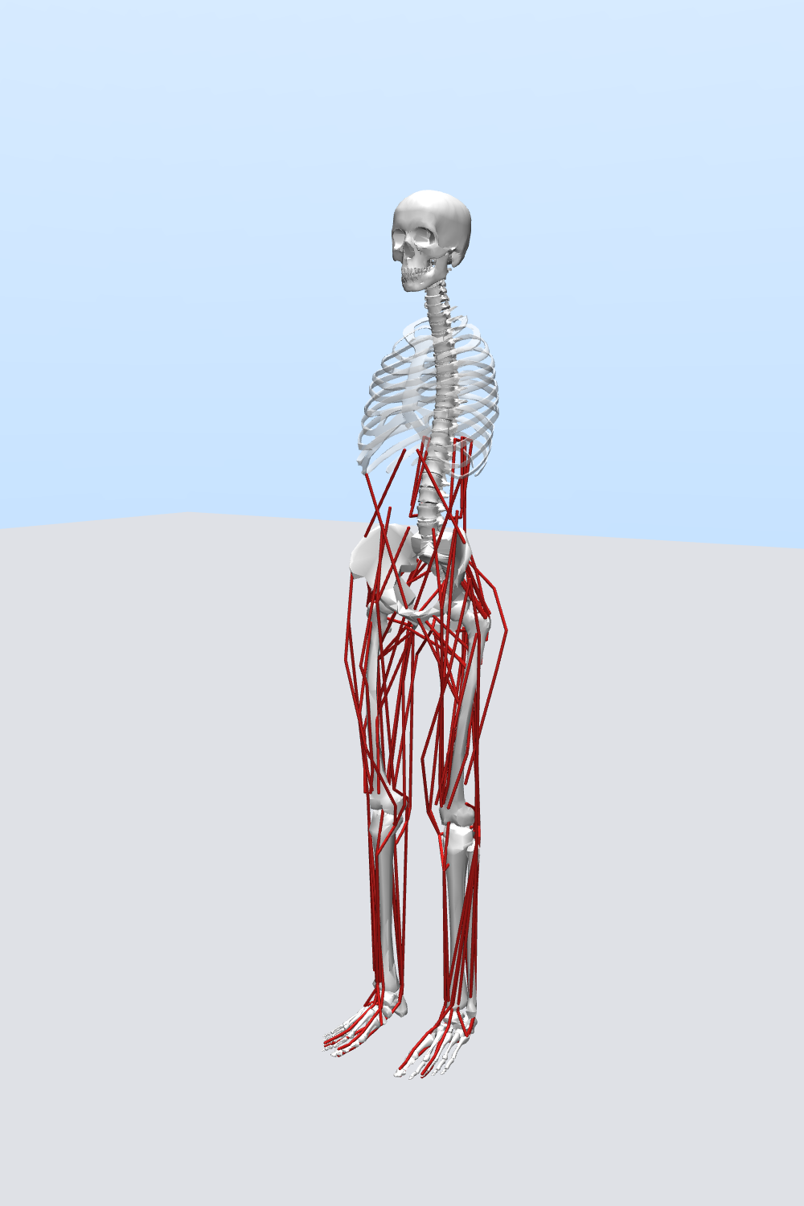
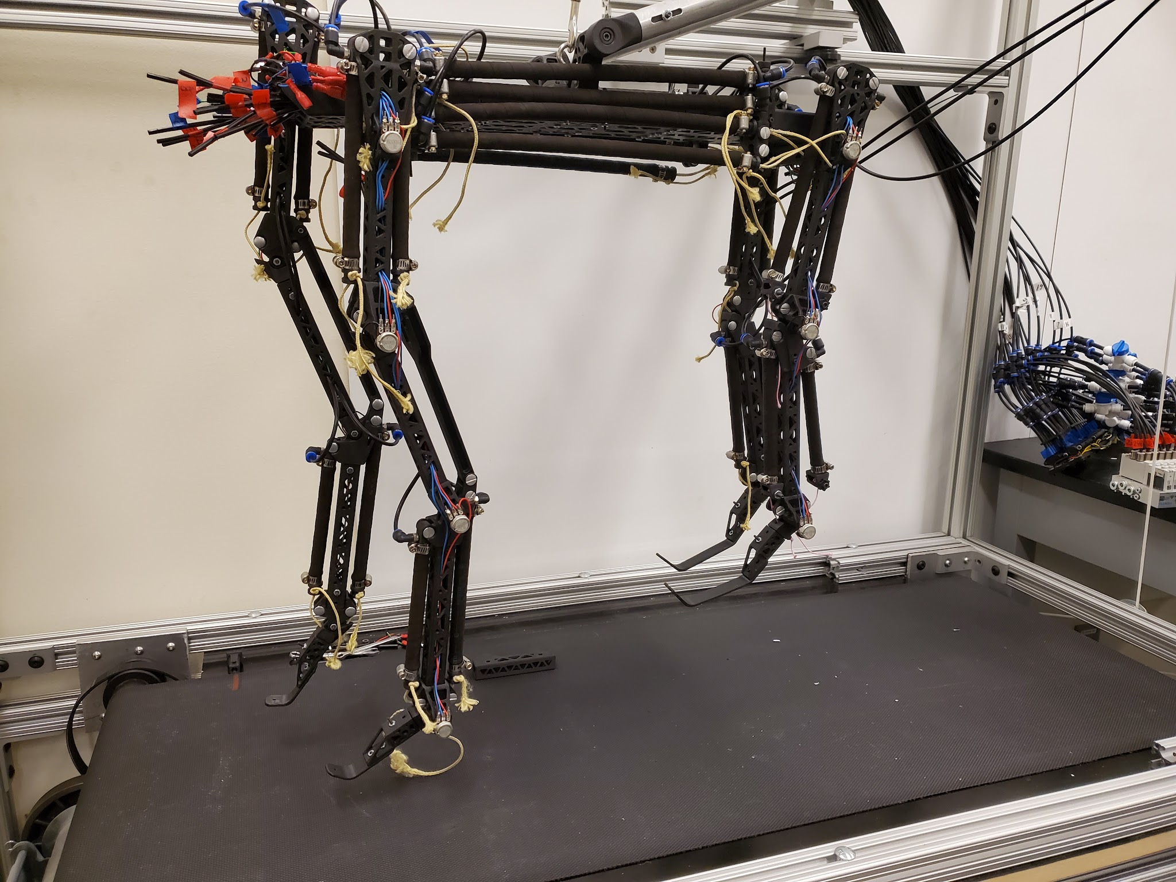
THE PROJECT
A humanoid robot from the trunk down: human-like body plan, synthetic nervous system
GUIDING HYPOTHESIS
human-like muscle numbers, architecture, routing + human-like torque capability, controlled by a biologically grounded neural architecture → biomimetic movement
BUILT ON
my master's work: Gait2392-matched kinematics, muscle routing tools · Morrow: optimized attachments · Steele: biomimetic 4-bar knee · Scharzenberger: BPA quadruped
THIS DISSERTATION
the quantitative basis: characterize the actuator, correct the joint model against experiment, validate against human torque, define the control path
converted leg model, 92 muscle paths
AARL quadruped: BPA actuators + SNS, already on a treadmill
Bolen & Hunt 2019; Morrow et al. 2020; Steele 2018; Scharzenberger et al. 2019
3
Notes:
Ground the committee: this dissertation is the actuator-and-joint foundation of the AARL humanoid program.

Slide 4
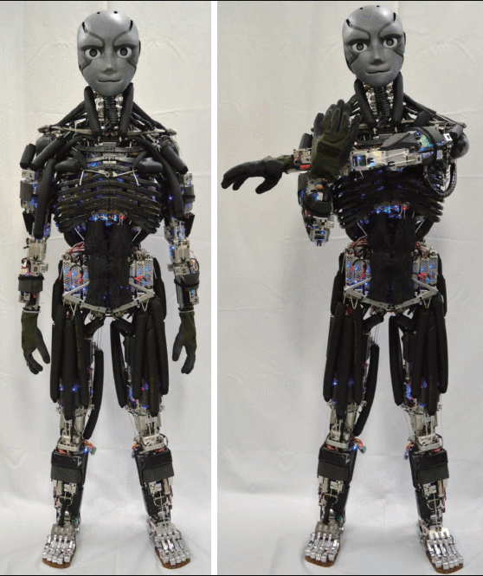
WHY BIOMIMETIC ROBOTS
Robots run neuromechanical experiments that are impossible in living subjects
Biology
anatomy · architecture · afferents
– Remove one muscle from the system
– Block one sensory feedback pathway
– Stimulate a named neural pathway
design principles
test hypotheses
– Identical copies - no individual variance
– Faster, cheaper, ethical vs. human studies
Robot
actuators · routing · controller
Loss-of-function and stimulation experiments
are the point of the platform.
human-mimetic musculoskeletal humanoid
Ijspeert 2020; Shin et al. 2018; photo: Asano et al. 2016, Humanoids
4
Notes:
The biology professor on the committee will recognize this loop: model, perturb, understand.

Slide 5
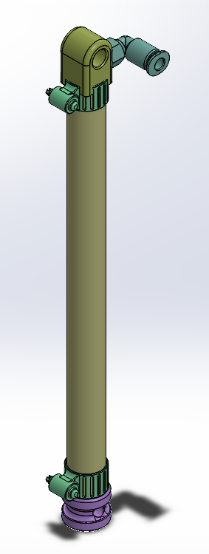
THE ACTUATOR
Braided pneumatic actuators: muscle-like strengths, and three modeling headaches
WHY WE USE THEM
WHY THEY ARE HARD
+ High force-to-weight, low mass
– Maximum force occurs AT resting length
+ Intrinsic compliance - safe, spring-like
– Contraction limited (max ≈ ε₆₂₀)
+ Tension-only, like biological muscle
– F highly nonlinear in l₀, P, ε
+ Force-length curve qualitatively muscle-like
– Manufacturer tool mis-predicts short BPAs
Designing a biomimetic robot around BPAs needs quantitative, predictive models:
actuator force → joint torque → comparison with human capability
Festo DMSP-10/20
Hunt et al. 2017; Sárosi et al. 2012-2017; Martens & Boblan 2017; Festo DMSP datasheets
5
Notes:
Sets up gap 1. Force peaks AT resting length - unlike a biological muscle whose optimum is mid-range.

Slide 6
PROBLEM STATEMENT
Three gaps stood between the existing design and a robot that walks
GAP 1
Actuator force models inadequate for design
Festo tool over-predicts short BPAs; published models fit a single length each
GAP 2
Actuator force ≠ joint torque
brackets, artificial tendons, wrap paths: unknown losses; optimized biomimetic routing never validated vs. human torque
GAP 3
No pipeline from musculoskeletal model to biologically realistic controller
two-level CPG ingredients existed, never assembled for a BPA biped with human-like routing
Aims 1-3 mirror the gaps →
Dissertation Ch. 1 §1.3
6
Notes:
Each gap maps to one aim. The committee heard these as the research objectives.

Slide 7
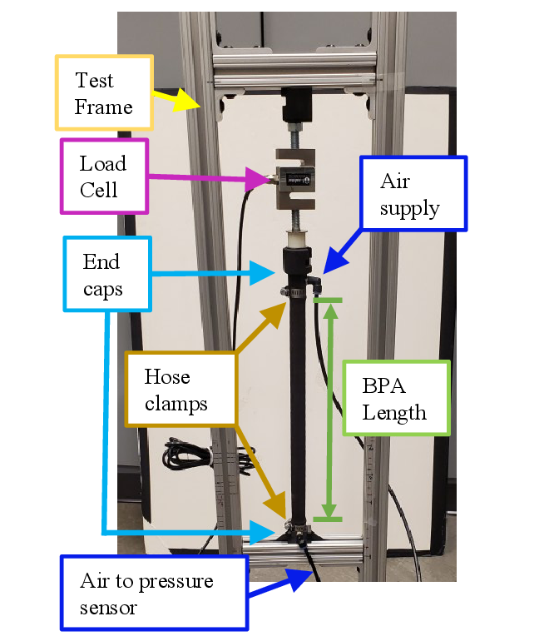
AIM 1 · ACTUATOR CHARACTERIZATION
A custom jig measured isometric force across resting length, pressure, and contraction
DIAMETERS
10 mm and 20 mm Festo DMSP
RESTING LENGTHS
112-518 mm (10 mm) · 300-509 mm (20 mm)
PRESSURE
up to P₆₂₀ = 620 kPa supply
DATA
537 force-pressure-contraction pairs (321 + 216)
INSTRUMENTATION
S-type load cells + HX711 · MPX5700 pressure · Arduino → MATLAB
Bolen, Elzein, Pang, Hunt 2026, Actuators (Ch. 3)
7
Notes:
Hardware slide - one breath. The point: wide l0 range, both diameters, 537 pairs.

Slide 8
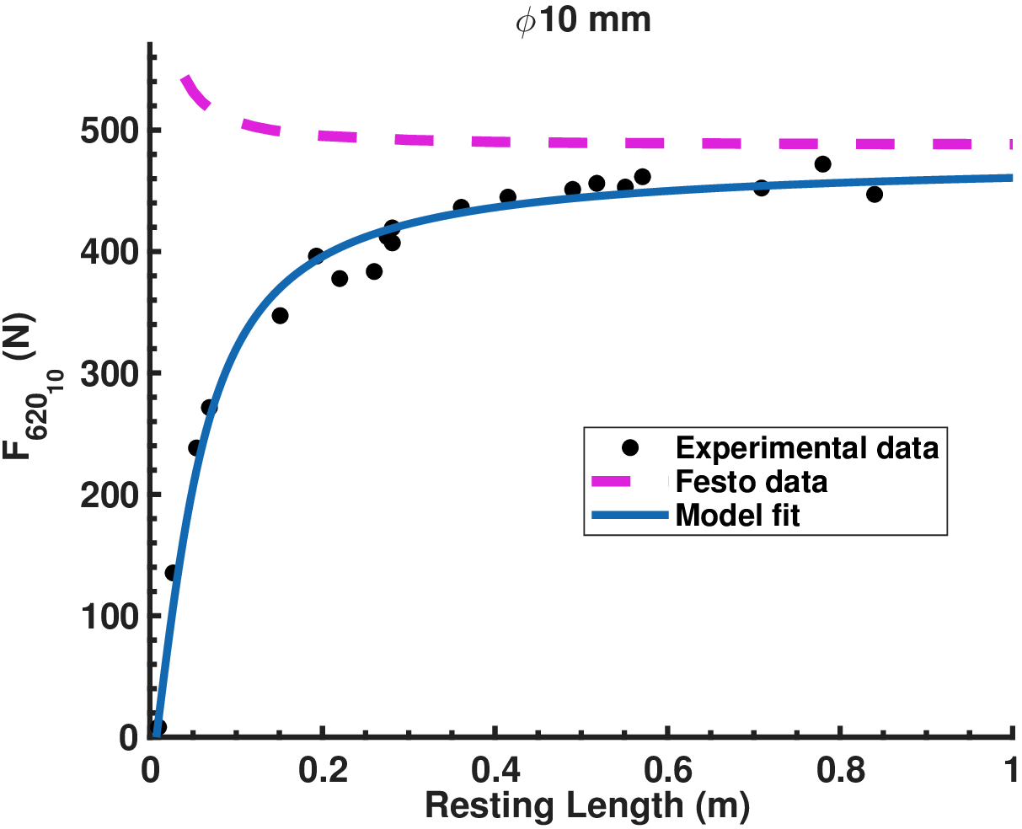
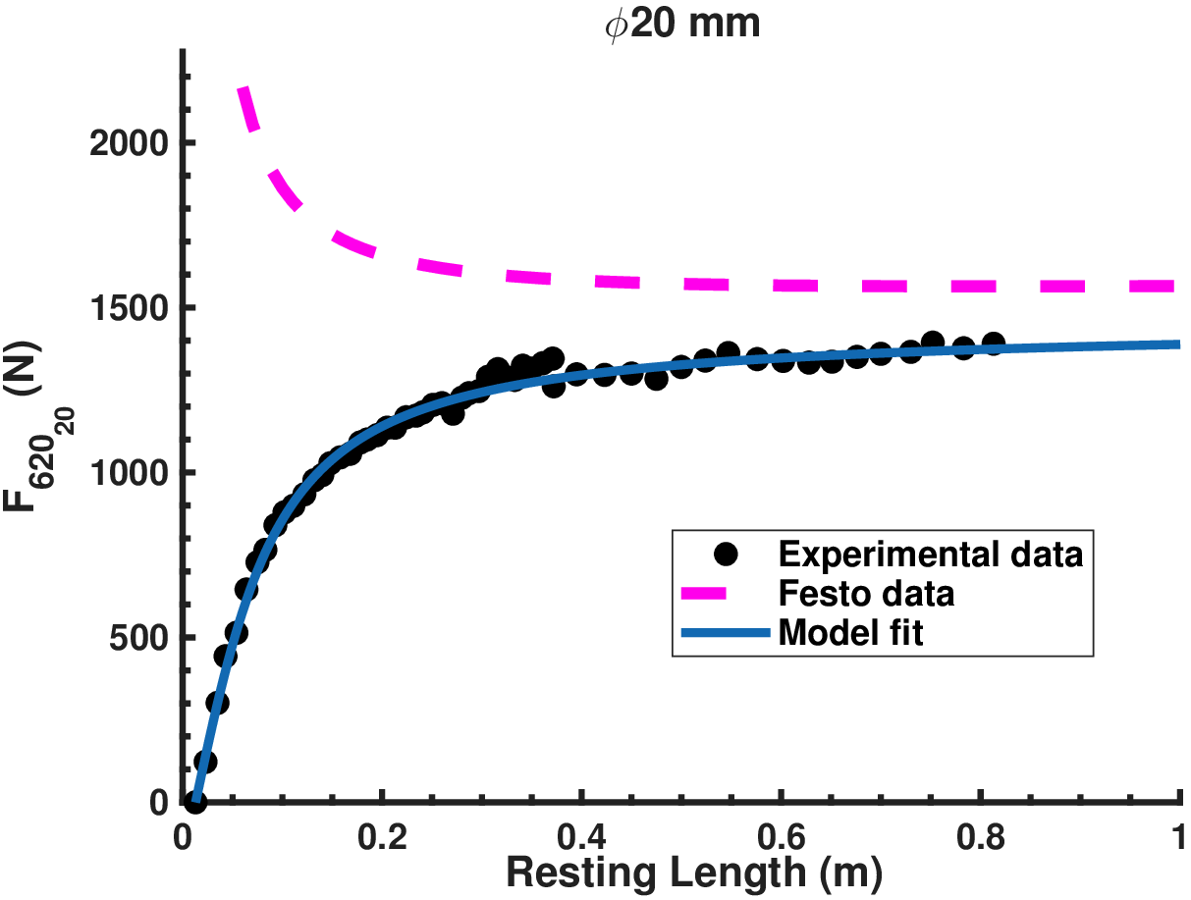
AIM 1 · ACTUATOR CHARACTERIZATION
Maximum isometric force depends on resting length - a previously unreported characteristic
φ 10 mm: F₆₂₀ vs l₀
φ 20 mm: F₆₂₀ vs l₀
solid: our arctan fit (data-driven) · dashed: Festo tool - predicts force INCREASING as l₀ shrinks
Bolen et al. 2026, Actuators, Figs. 2-3
8
Notes:
The discovery slide. Festo's own tool predicts the OPPOSITE trend - force rising as length shrinks.

Slide 9
AIM 1 · ACTUATOR CHARACTERIZATION
Two coefficients per diameter capture the resting-length effect
LIMITS BEHAVE
l₀ → ∞: 470 N (10 mm) vs Festo 490 N
within Festo's stated 10% manufacturing tolerance (20 mm: 1460 vs 1570 N)
THE OFFSET IS PHYSICAL
7.5 mm / 13 mm = length at which the end caps contact each other in the CAD model - no contractile stroke remains
As l₀ → 0, measured force → 0.
Bolen et al. 2026, Actuators, Eqs. 4-6; fit: nonlinear least squares, least-absolute-residual
9
Notes:
Math committee: arctan form, bounded asymptote, physical offset from end-cap contact in CAD.

Slide 10
AIM 1 · ACTUATOR CHARACTERIZATION
At short resting lengths the manufacturer's tool mis-predicts force by 42%
WHY THE TOOL FAILS SHORT
Ideal cylindrical models ignore end effects; the clamped ends force steep stress gradients.
The end-effect zone has roughly fixed length - so as l₀ shrinks, it dominates.
Measured force → 0 as l₀ → 0. The Festo tool instead predicts exponential growth.
“Researchers using BPA resting lengths under 300 mm should take note.”
error: 4.5% (ours) vs 42.1% (Festo)
Bolen et al. 2026, Actuators, Discussion §1; example: φ10 mm, l₀ = 112 mm, 620 kPa
10
Notes:
The design-relevant failure: anyone specifying BPAs under 300 mm gets burned by the tool.

Slide 11
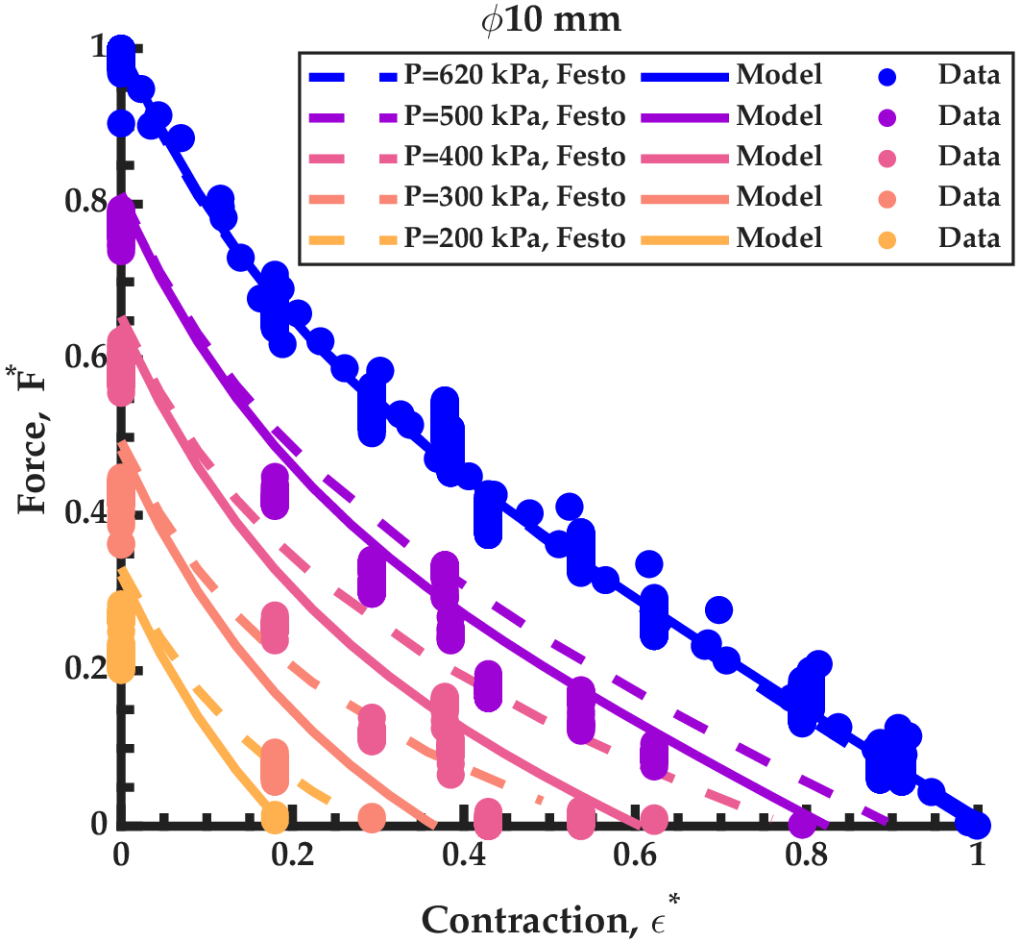
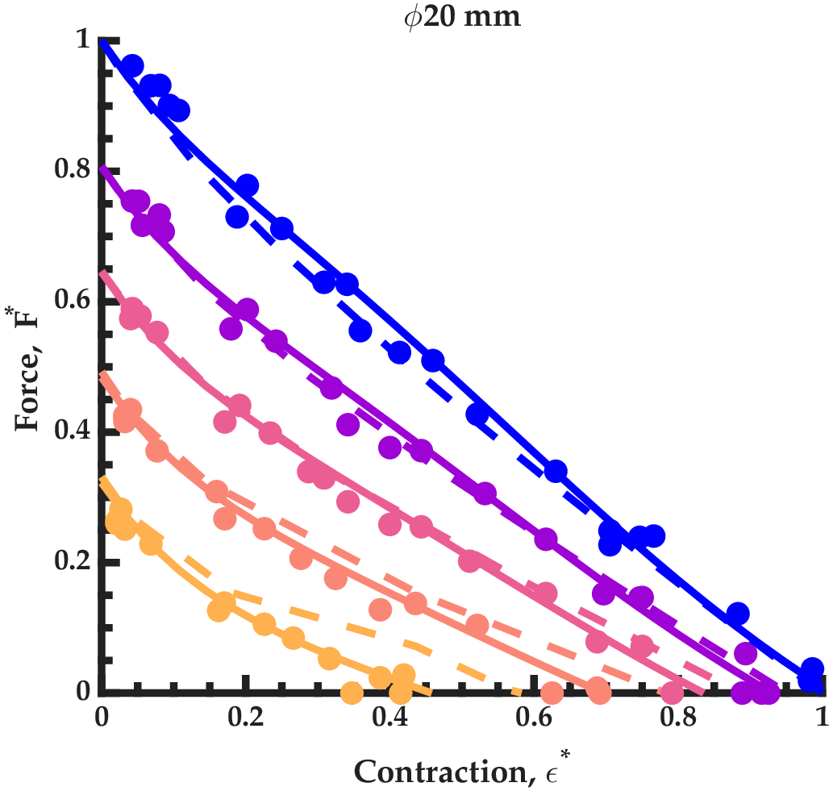
AIM 1 · ACTUATOR CHARACTERIZATION
All 537 measurements collapse onto one dimensionless force surface
F*(ε*, P*) - φ10 mm, pressure isoclines
F*(ε*, P*) - φ20 mm
Bolen et al. 2026, Actuators, Eqs. 7-9; ε* = ε/ε₆₂₀, P* = P/620 kPa
11
Notes:
Normalization by each muscle's own F620 and eps620 is what makes one surface fit all lengths.

Slide 12
AIM 1 · ACTUATOR CHARACTERIZATION
Three coefficients per diameter: force predicted out-of-sample to a few percent
adj. R² (fit)
adj. R² (validation)
max err (fit)
max err (val.)
φ 10 mm
0.9998
0.9994
10.3%
10.6%
φ 20 mm
0.992
0.9943
6.8%
5.7%
RMSE (normalized): 0.005 (10 mm) · 0.023 (20 mm)
The whole actuator model a designer needs:
F* (3 coefficients, per diameter) × F₆₂₀(l₀) (2 coefficients, per diameter)
Bolen et al. 2026, Actuators, Table 2; 80/20 train/validation split
12
Notes:
Stress: validation is 20% held out, and max error under ~11% everywhere - at ANY length.

Slide 13
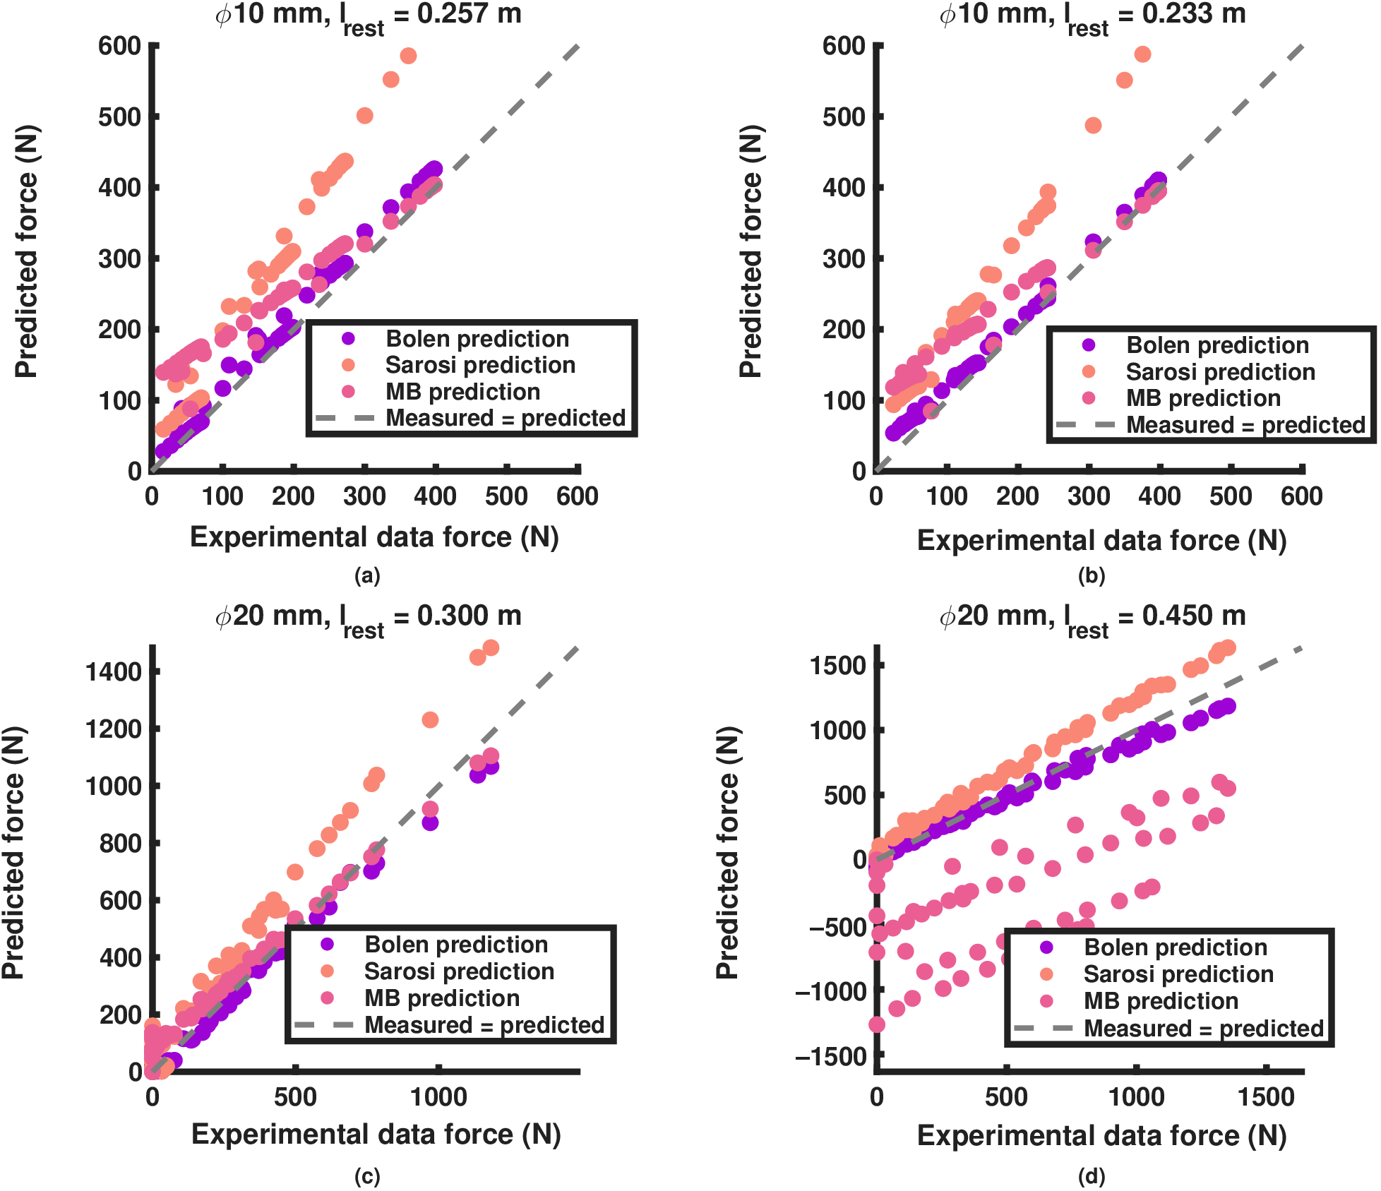
AIM 1 · ACTUATOR CHARACTERIZATION
Lowest error of the compared models at every diameter and length tested
RMSE (N) at matched conditions
l₀
Bolen
Sárosi
M&B
10 mm, 257 mm
22.9
143.8
73.8
10 mm, 233 mm
16.8
132.7
62.6
20 mm, 300 mm
35.6
132.1
72.8
20 mm, 450 mm
67.6
177.7
862.1
Normalization travels: one fit per diameter works across lengths,
while fixed-parameter models fail when moved off their fit length.
measured vs predicted; y = x is perfect fit
Bolen et al. 2026, Actuators, Fig. 5 + Table 3; full table in Appendix C
13
Notes:
Sarosi params come from specific lengths - extrapolation is where they fail. Martens is geometry-sensitive.

Slide 14
AIM 1 → AIM 2
The force model is two cheap maps - built to sit inside a real-time controller
MAP 1
MAP 2
F₆₂₀(l₀)
resting length → max force
F*(ε*, P*)
strain, pressure → fraction
Closed form or lookup table; evaluated per timestep in the plant model.
Next: multiply by geometry (moment arm) → joint torque. Does it survive contact with the joint?
Bolen et al. 2026, Actuators, Discussion §4; dynamics complement: Elzein et al. 2025
14
Notes:
Static map = feedforward plant model / lookup table. Valve-airflow dynamics are the Elzein layer.

Slide 15
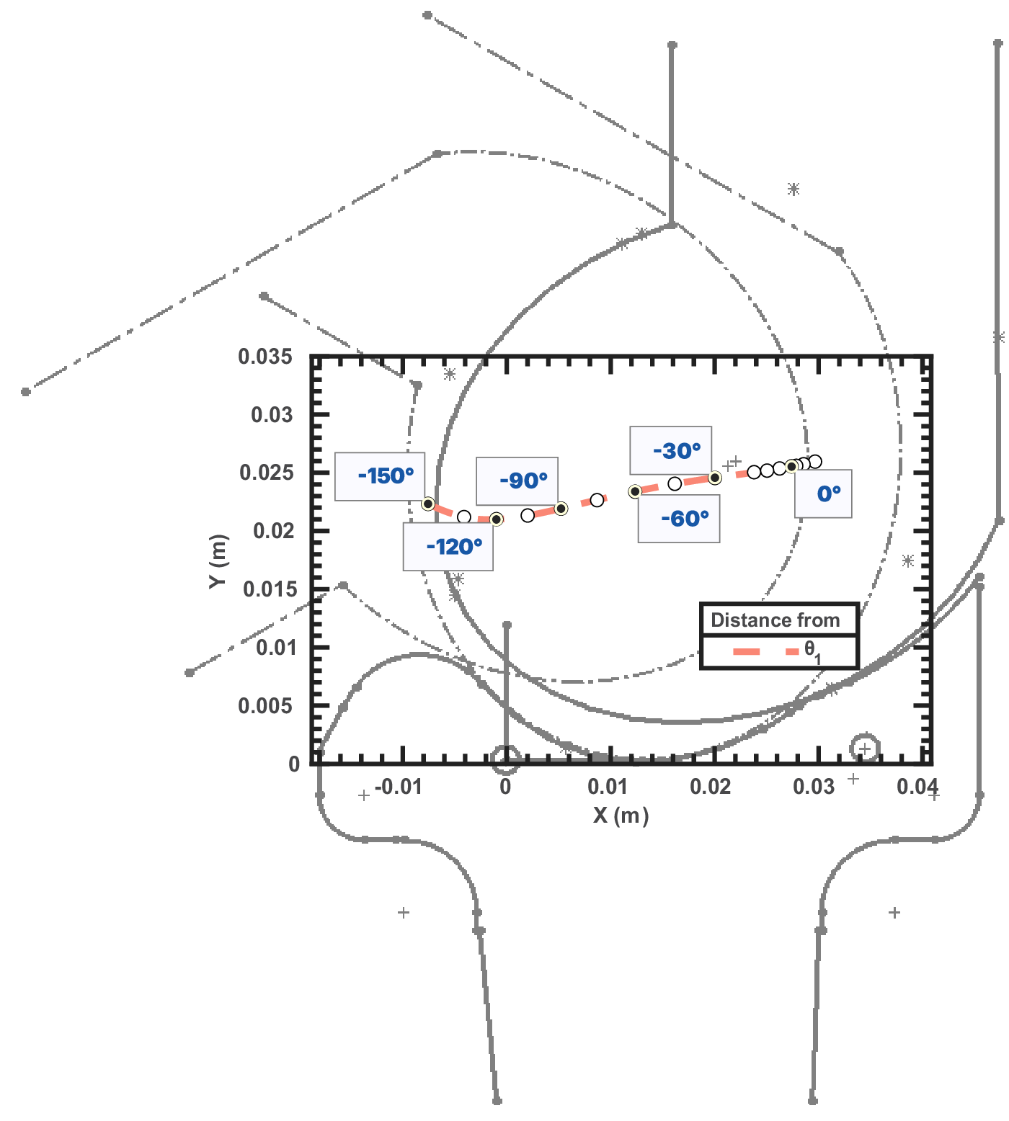
AIM 2 · JOINT TORQUE
Two test stands: a pinned knee exposes the losses; the biomimetic four-bar validates them
FOUR-BAR KNEE
Crossed links give a migrating instantaneous center of rotation - posterior and distal with flexion, like the human knee.
Torque depends on the ICR: getting it right matters for both prediction and experiment.
Each joint: one flexor + one extensor BPA, 10 mm (and 20 mm on the biomimetic flexor).
pinned-joint stand (CAD + test photo)
biomimetic knee: migrating ICR
Bolen et al., in preparation 2025 (Ch. 3-4); four-bar knee: Steele 2018
15
Notes:
Same CoR in femur frame at 0 deg. Co-axial with gravity so measurements stay isometric.

Slide 16
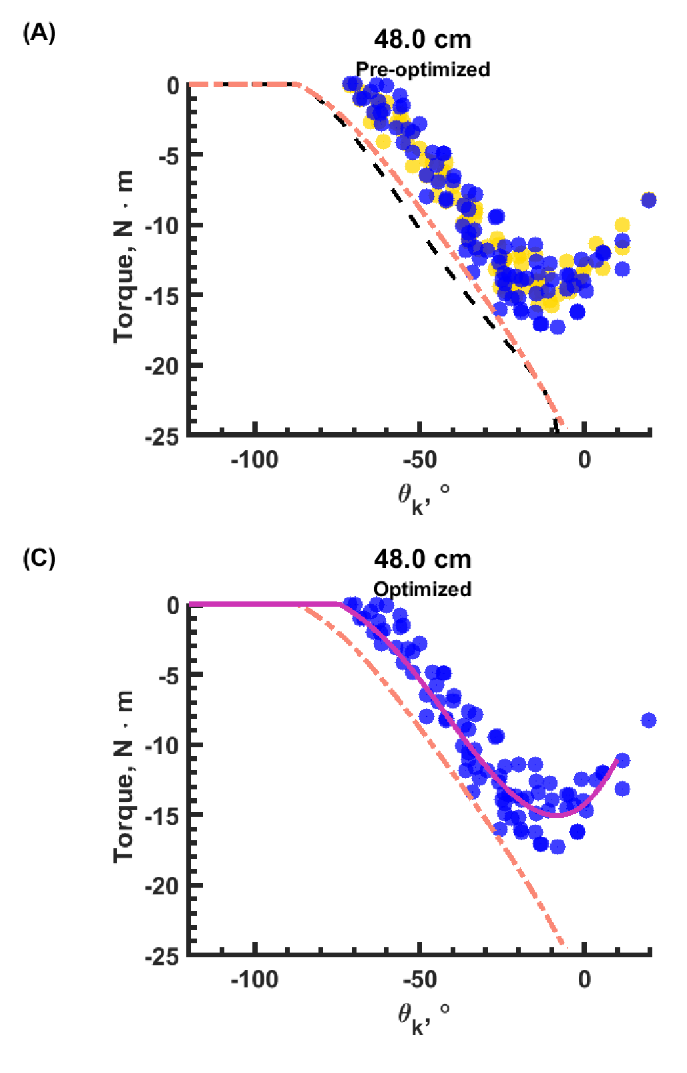
AIM 2 · JOINT TORQUE
The hybrid method shows the error is kinematic, not force
HYBRID TORQUE
M = r × F with measured muscle length and angle, model force
Hybrid ≈ measured ✓
the validated force model is not the problem
Rigid prediction ≠ measured ✗
the kinematics (Lₘ, rₖ) are what the model gets wrong
yellow = hybrid · blue = measured · black dashed = original model
Bolen et al., in preparation 2025, Fig. 6 A-B (panels: pre-optimized pinned flexor)
16
Notes:
Yellow = hybrid (measured Lm, rk + model force). It tracks measurement: so the force model is fine; Lm and rk predictions were wrong.

Slide 17
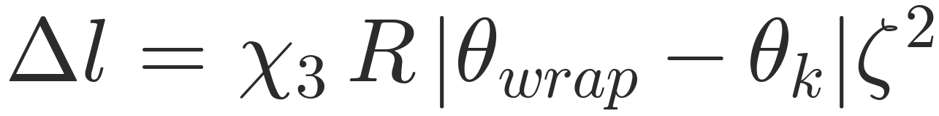
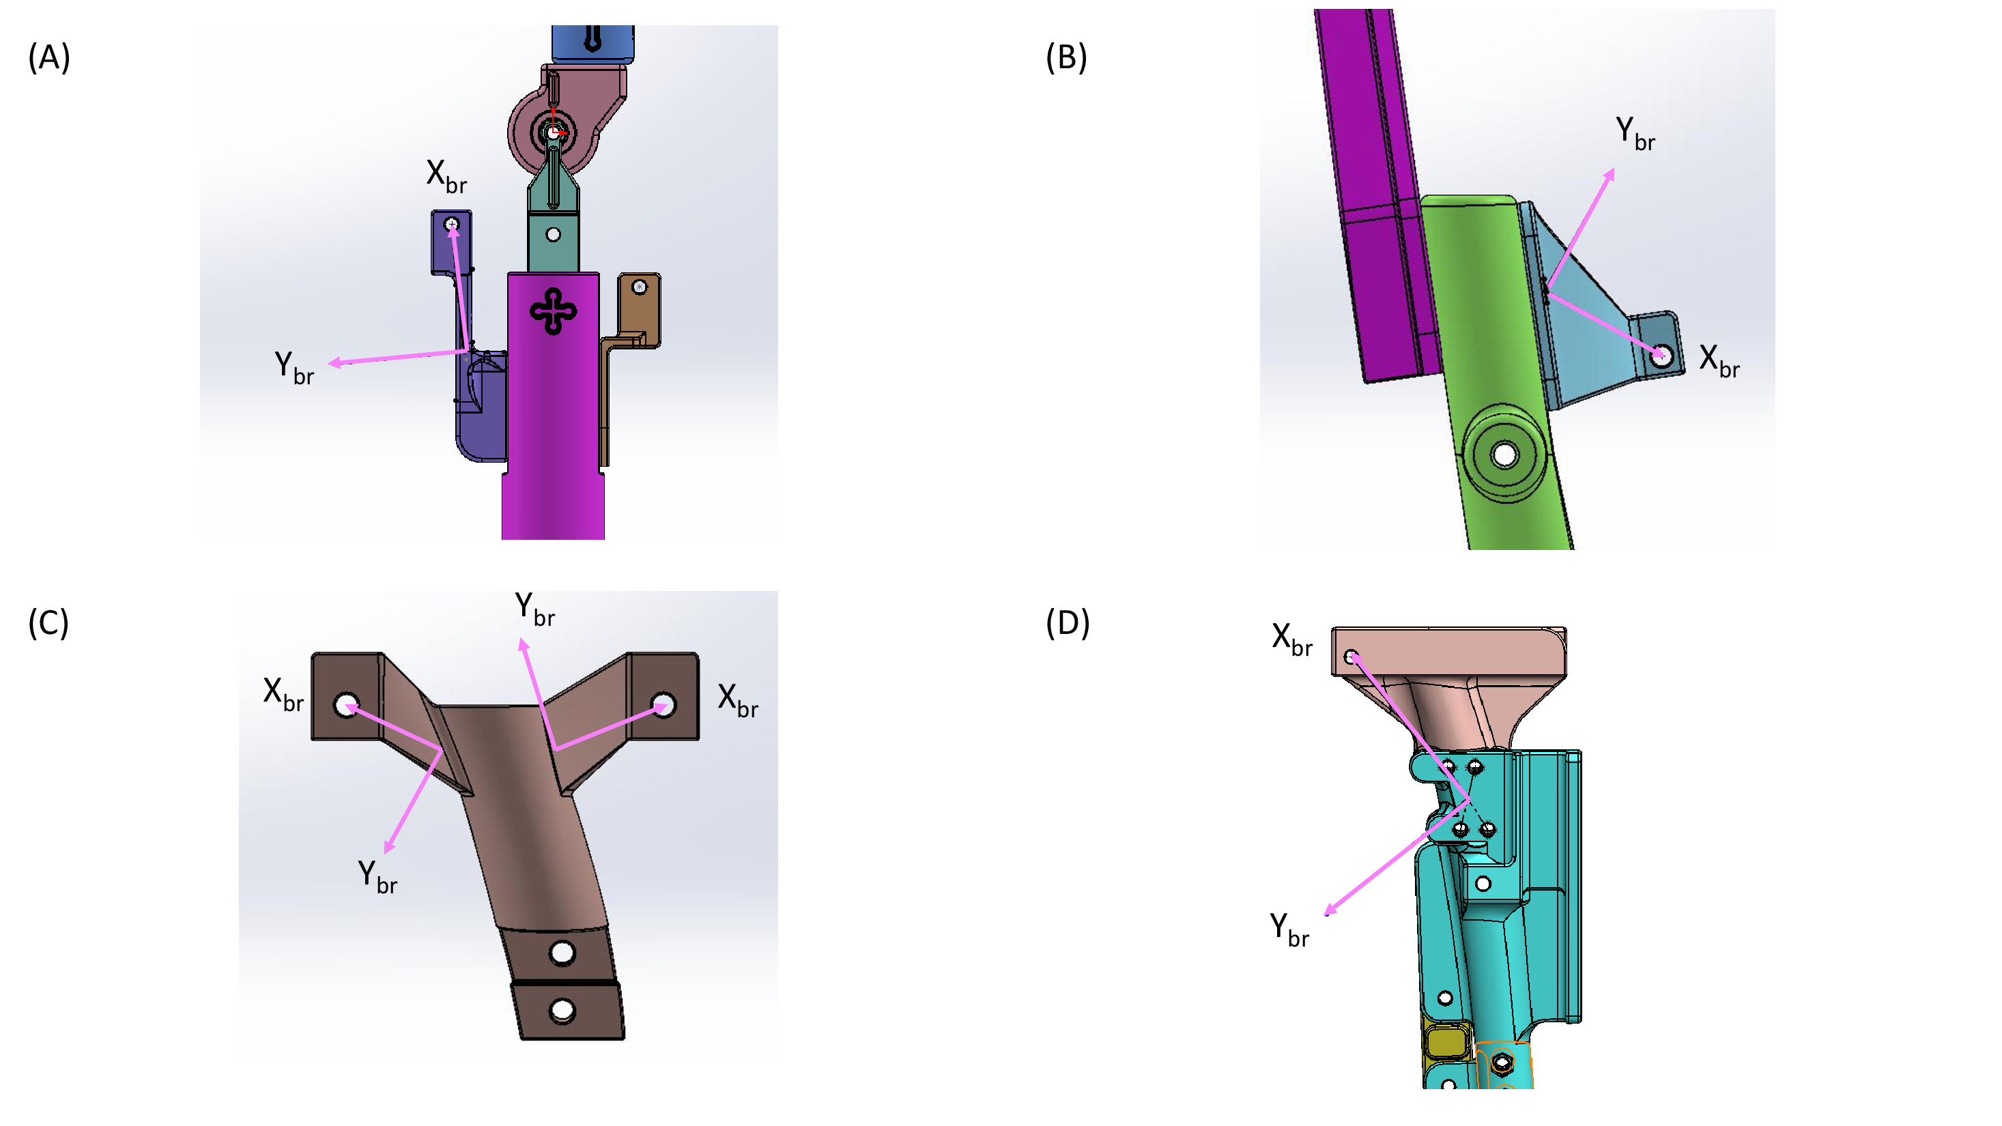
AIM 2 · IMPROVED TORQUE MODEL
Three physical effects close the gap: length offset, series compliance, wrap loss
χ₀ · constant length offset
χ₁, χ₂ · bracket compliance
χ₃ · wrapping loss (θₖ ≤ θ_wrap)
Measured muscle length is consistently shorter than predicted at every angle - including at ε = 1, F = 0. That is a constant offset.
Hooke law in bracket principal directions; compliance projected on the force direction û; artificial tendon added in series.
A BPA bent over the joint loses usable arc length: inner side carries less tension. Loss grows with the complement of strain, ζ = 1 − ε*.
Solved by nonlinear force balance
F₆₂₀(l₀) · F*(ε*(δ), P*) − kₑₔ δ = 0 → δ (Newton / bracketed solve), then length, path, moment arm, torque recomputed.
bracket frames per configuration
Bolen et al., in preparation 2025, Eqs. 10-16; bracket frames: Fig. 3.4
17
Notes:
chi1/chi2 are EFFECTIVE system stiffness (bracket + fixtures + winch), not literal beam stiffness - be ready for that question.

Slide 18
AIM 2 · IDENTIFICATION PROTOCOL
Terms identified by multiobjective optimization, judged on held-out tests
5 pinned-flexor tests
(48 / 46 / 47 / 40-tendon / 41 cm)
train on 4
hold out 47 cm
Pareto front
{RMSE, FVU, max res.}
pick: held-out fit +
cross-configuration
flexor fit solves (χ₀, χ₁, χ₂) with TWO brackets
(origin + insertion), shared stiffness pair
extensor refit LOCKS (χ₁, χ₂) to the flexor front,
solves only (χ₀, χ₃); χ₀ allowed negative
Bounds of record (Appendix C)
flexor: χ₀ ∈ [0, 20] mm · χ₁ ∈ [3×10⁴, 10⁶] N/m · χ₂ ∈ [5×10³, 2×10⁴] N/m
extensor: χ₀ ∈ [−20, 0] mm · χ₃ ∈ [0, 1] · (χ₁, χ₂) = flexor front, never searched
gamultiobj / NSGA-II (Deb 2002); sources: minimizeFlxPin10mm_2brk.m, minimizeExt10mmX3.m
18
Notes:
Key protocol choices: encoder-corrected 47 cm is NEVER trained on by the flexor fit; extensor locks stiffness to the flexor front.

Slide 19
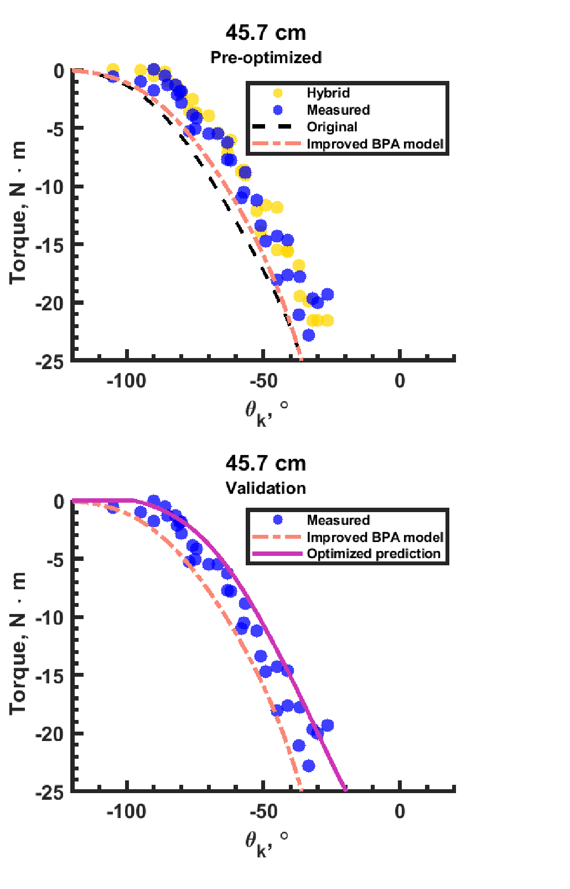
AIM 2 · PINNED FLEXOR
With corrections, prediction tracks measurement - including the dip at small angles
THE MISSING DIP
The rigid model completely missed the torque reduction at small flexion angles.
The corrected model captures it.
VALIDATION
45.7 cm BPA: different length, different working range, never in the fit.
Bolen et al., in preparation 2025, Fig. 6 C-D
19
Notes:
Panel C: fit on 48 cm. Panel D: 45.7 cm never used in the fit - different muscle over a different ROM.

Slide 20
AIM 2 · PINNED FLEXOR
Held-out flexor errors stay near 1-2 N·m across all five tests
FVU
0.14 / 0.06 / 0.17 / 0.04 / 0.03
* 47 cm test
encoder read 5.3° low; corrected on experimental angles - and never trained on.
No test is garbage; every test predicts.
minimizeFlxPin10_results_20260908_2brkt_2trans_noT3.mat, front row 107 of 212 (adopted); FVU at right
20
Notes:
47 cm is pure hold-out with the encoder correction (+5.3 deg on experimental angles). FVU < 0.17 everywhere.

Slide 21
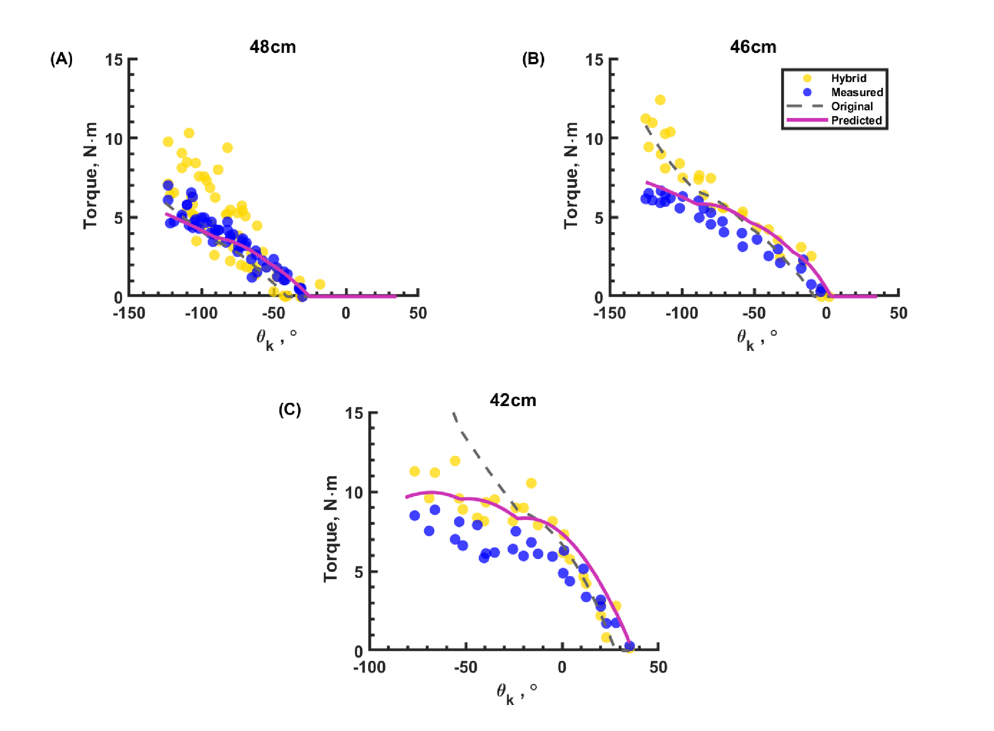
AIM 2 · PINNED EXTENSOR
The extensor wraps the joint - and χ₃ recovers the length it loses there
χ₀ = −10.1 mm
extensor offset: same magnitude scale, OPPOSITE sign to flexor (+8.9 mm)
χ₃ = 0.621
fractional wrap loss acting on arc length × ζ²
0.56-1.88 N·m
held-out RMSE with corrections
vs 0.95-3.62 N·m
uncorrected rigid baseline - improved in every pool test (6/6)
minimizeExt10mmX3_results_20260910_noT3.mat, driver pick 1 (six-test validation pool)
21
Notes:
chi0 flips sign relative to flexor: -10.1 vs +8.9 mm. Held-out RMSE 0.56-1.88 vs baseline 0.95-3.62: improved in every pool test.

Slide 22
AIM 2 · VALUES OF RECORD
One stiffness pair of record spans the flexor and extensor configurations
Term
Value
Source
Row
READ THIS TABLE LIKE THIS
Rows 107 and 1 are two operating points on one and the same flexor Pareto front.
The pinned-flexor data admit a family of stiffness pairs of comparable fit; the adopted pair is the one that also performs across configurations.
The extensor never searches stiffness - it inherits it.
Flexor χ₀
+8.9 mm
flexor mat
107
Flexor χ₁
5.62×10⁴ N/m
flexor mat
107
Flexor χ₂
1.85×10⁴ N/m
flexor mat
107
Extensor χ₀
−10.1 mm
extensor mat
1
Extensor χ₁ (locked)
4.354×10⁴ N/m
flexor mat
1
Extensor χ₂ (locked)
1.701×10⁴ N/m
flexor mat
1
χ₃
0.621
extensor mat
1
Dissertation App. C, Table C.2; flexor mat: ...20260908_2brkt_2trans_noT3, extensor mat: ...20260910_noT3
22
Notes:
Advisor requirement satisfied: one (chi1, chi2) across configurations. Note both rows are operating points on ONE flexor Pareto front - the data admit a family; this is the honest statement.

Slide 23
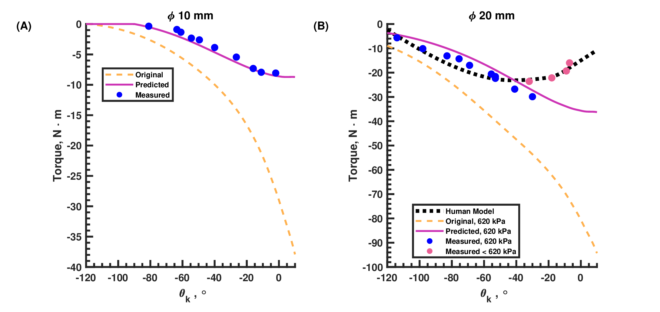
AIM 2 · BIOMIMETIC KNEE
The biomimetic knee meets or exceeds human flexor torque over most of the range of motion
SHORTFALL
60-100° (±20%: 78-103°)
φ20 mm, 41.5 cm RMSE 1.80 FVU 0.05
At 620 kPa the BPA exceeded the test femur's ultimate strength - remaining points taken at reduced P.
Bolen et al., in preparation 2025, Fig. 9; human curve: Gait2392 (Delp 2007; Seth 2018)
23
Notes:
Panel B is the headline. Be upfront about the 60-100 deg shortfall (78-103 at +/-20%). The femur note usually gets a laugh: at 620 kPa we exceeded the ultimate strength of the test femur, so higher-pressure points were measured at reduced P.

Slide 24
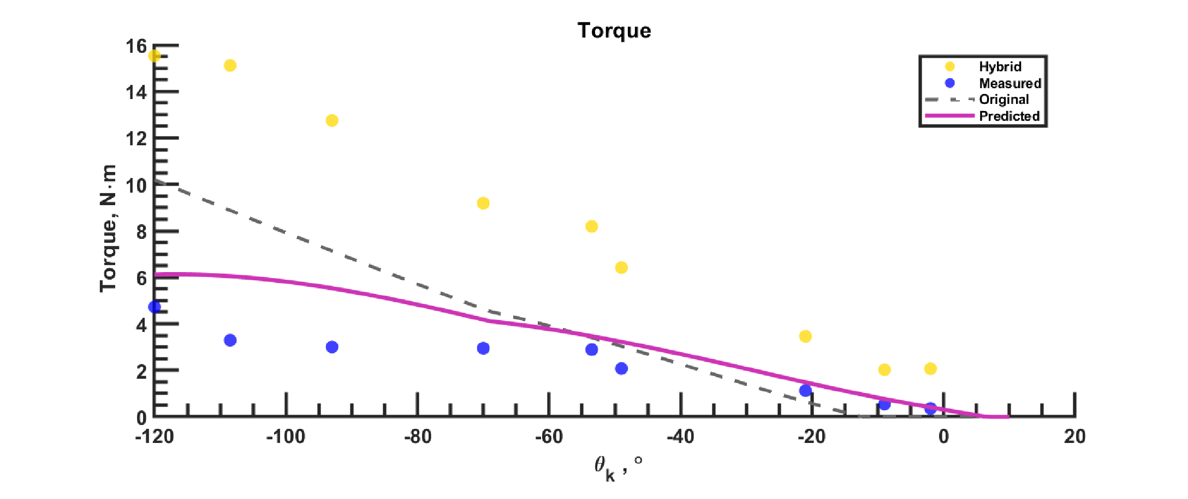
AIM 2 · BIOMIMETIC KNEE
Biomimetic extensor: the corrections halve the error, but variance is still under-predicted
2.20
RMSE (N·m) vs 3.03 baseline
2.35
FVU vs 4.49 baseline
4.73
max resid (N·m) vs 5.59 baseline
CLAIM CONTROL
FVU > 1: no validated bio-extensor prediction is claimed. Improvement over baseline is unambiguous; closure is not.
φ10 mm extensor on the four-bar knee, l₀ = 51.8 cm
l₀ = 51.8 cm test; values of record: RMSE 2.20 / FVU 2.35 / max resid 4.73 (baseline 3.03 / 4.49 / 5.59)
24
Notes:
Honesty slide. Improvement is unambiguous; validation is NOT claimed for the bio-extensor. FVU > 1 means the corrected model under-predicts the measured torque variance.

Slide 25
AIM 2 → ROBOT REDESIGN
The values of record now drive the full leg redesign optimizer
COST (route redesign)
J = 10⁵·J_worst + 10³·J_torque + aux + regularizers
Targets
human knee torque from Gait2392 - flexor vs biceps femoris short head, extensor vs vastus medialis
Solver
surrogateopt (≈7,000 evals) → patternsearch (≈15,000), parallel
LATEST RESULT - EXTENSOR REDESIGN
FEASIBLE with the χ values of record
thinnest torque margin +0.063% at −18.9°
contraction 0.69 · KMAX (within limit)
max path length 0.832 m
binding constraint −0.000442 (near-active at optimum)
flexor target carries a +1% torque margin above the human curve · extensor target is the raw curve · flexor routes mirrored about the mid-sagittal plane · Xi loaded directly from the results mats
Opt_run.m / Opt_run_Ext.m; latest: Vas_Pam_20mm_Result_20260910_0528.mat (feasible)
25
Notes:
Bridge slide to current work: same Xi loaded directly from the results mats by the context builders.

Slide 26
AIM 3 · SIMULATION PIPELINE
The plant moves into simulation: OpenSim → MuJoCo, verified end to end
Modified OpenSim robot model
robot routing, 92 muscles, corrected paths
MyoConverter
OpenSim → MuJoCo, muscle kinematics + kinetics
MuJoCo plant
92 muscle-tendon actuators · audited geometry · dynamically audited joint signs
SNS-Toolbox coupling
0.1 ms neural step · proprioceptive + contact channels in
converted model at reference pose
custom BPA force model ported 1:1 to Python - including the χ force balance
MyoConverter (Caggiano 2022); MuJoCo (Todorov 2012); model: modified Gait2392 robotbody
26
Notes:
Conversion is COMPLETE and verified: 92 actuators, attachment geometry audited against OpenSim source; joint sign conventions audited dynamically from simulation torques.

Slide 27
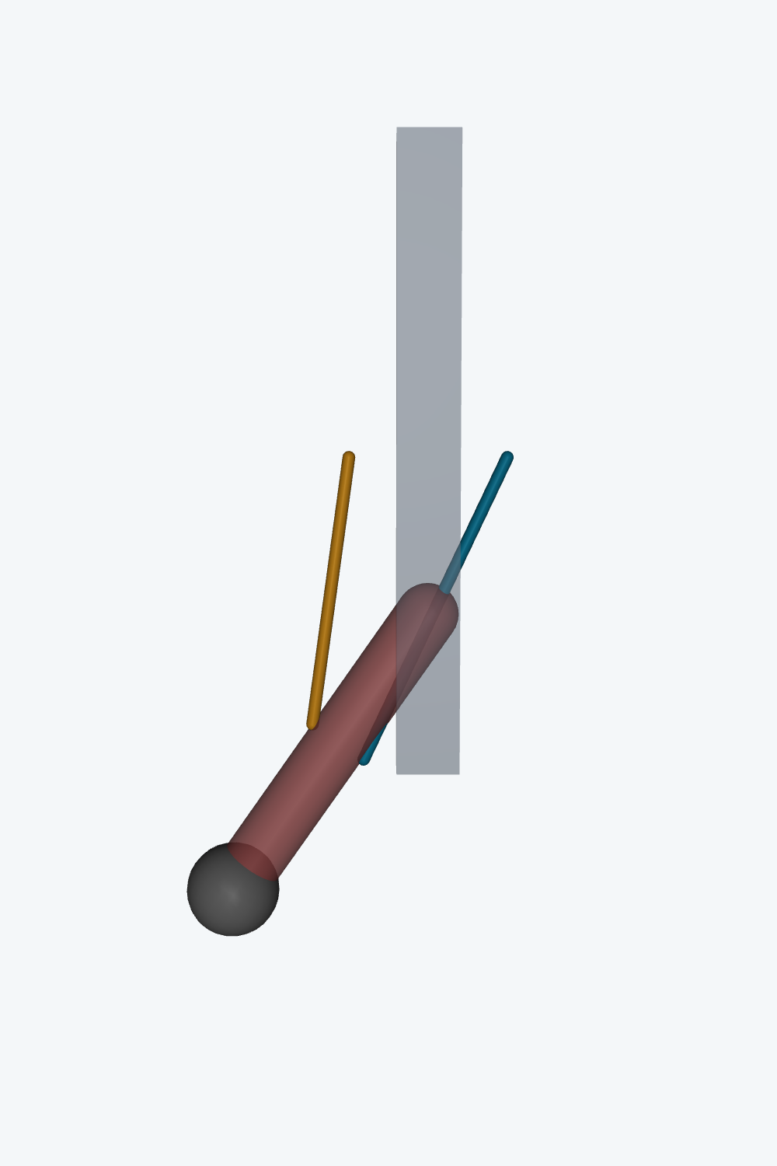
AIM 3 · PROOF OF INTERFACE
A synthetic antagonist-BPA knee already closes the loop in MuJoCo
SNS network
0.1 ms step
MN voltage → activation
sigmoid
MuJoCo mj_step
tendon forces
loop
force → Ib afferent
feedback
back to SNS
closed loop
synthetic knee at −35°; cyan/gold = named flexor/extensor routes
SNS-Toolbox (Nourse 2023); minimal SNS with reciprocal inhibition drives flexor + extensor BPAs
27
Notes:
This is the controller-actuator-joint interface demonstration - NOT yet SNS control of the full converted robot.

Slide 28
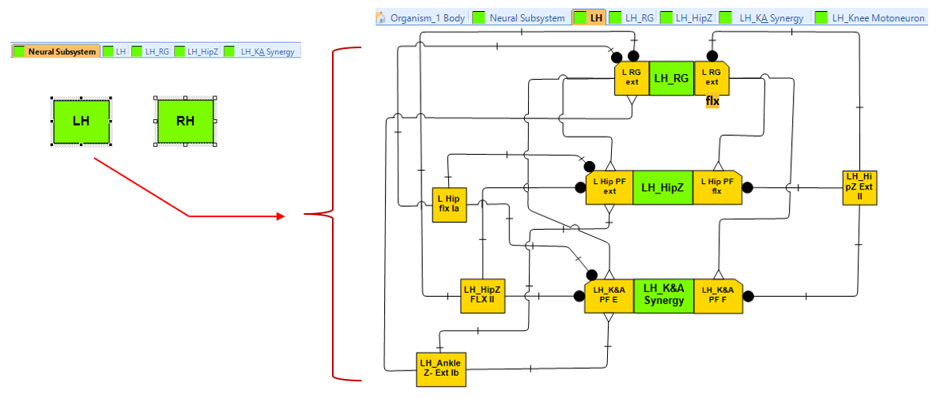
AIM 3 · SPINAL CONTROLLER
The spinal controller: two-level rhythm generation + pattern formation, per leg
BUILT AND VERIFIED
406-neuron spinal network on the converted model
per-leg RG half-centers + 4 phase-shifted PF groups
MN pools for all actuators; Ia / Ib / II afferent populations
RG alone oscillates: ≈0.89 s cycle, legs in antiphase (−0.88)
Open: full-body closed-loop co-simulation
per-side subsystems: RG · hip · knee-ankle pattern formation
Rybak 2006; McCrea & Rybak 2008; left-right coordination: Molkov 2015, Danner 2016
28
Notes:
406-neuron network assembled on the converted model. RG verified in ISOLATION: ~0.885 s period, antiphase -0.88. Full-body closed loop not yet running (leg NaNs under investigation).

Slide 29
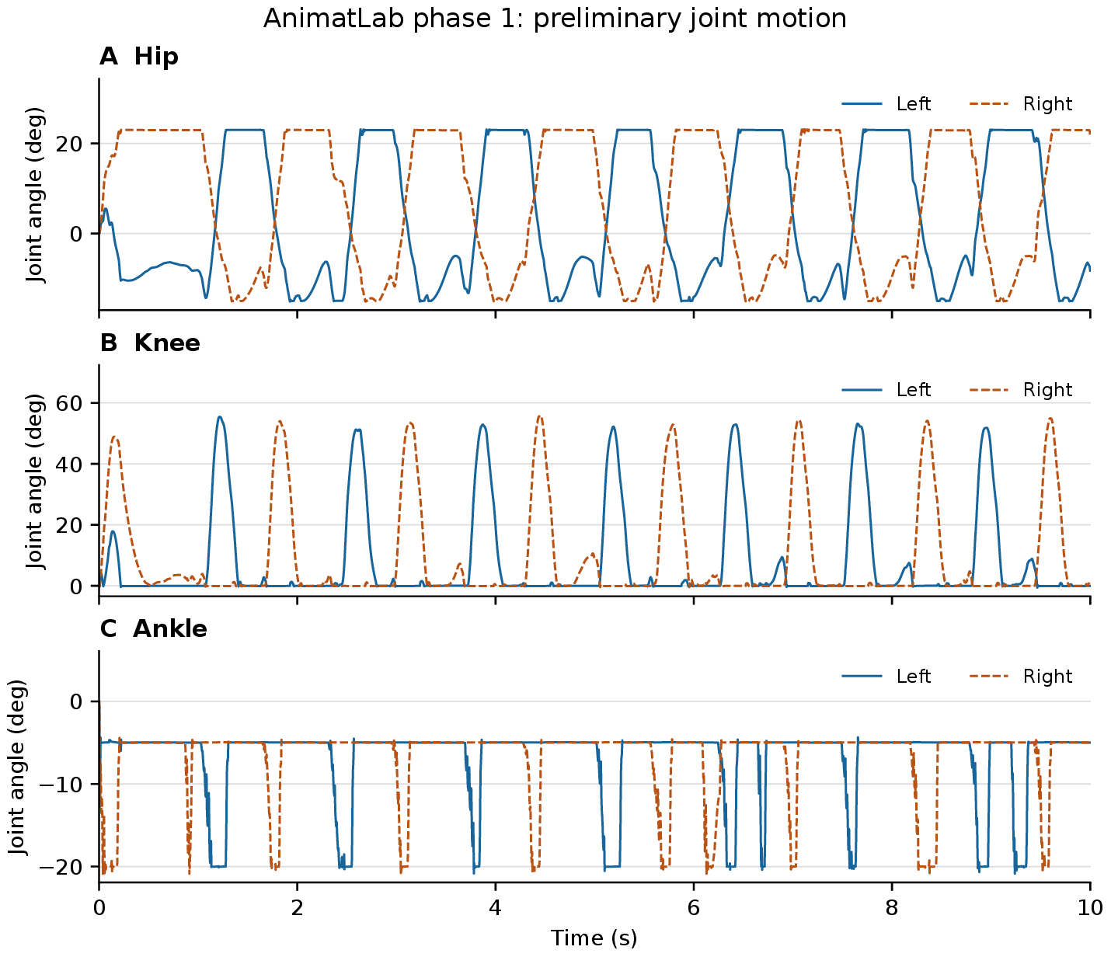
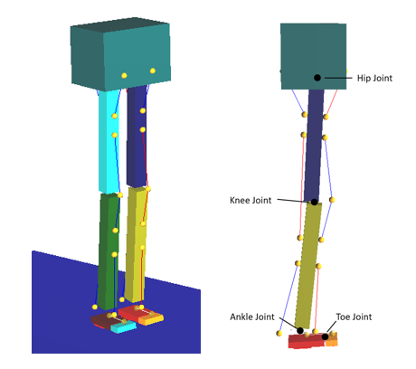
AIM 3 · THE SUSPENDED-WALKER LESSON
Feedforward rhythm produces stepping; only tuned feedback can support the body
WHAT IT TAUGHT
Suspended: alternating stepping in hip, knee, ankle - rhythm does not need sensory feedback (as the run at right shows).
On the ground: untuned afferents could not support the pattern.
→ proprioceptive + contact tuning is the critical path to weight-bearing walking.
Current: RG latches under tonic drive in the bilateral model - conductance tuning in progress.
9-body planar biped,
antagonist Hill pairs + passive toe
phase-1 instrumented run: 10 s,
hip / knee / ankle, both sides
Li et al. 2017 (biomech. synthesis); Deng et al. 2019 (two-layer CPG); AnimatLab: Cofer 2010
29
Notes:
This is the honest state of the neural side: rhythm generation is demonstrated; weight-bearing is the critical path, and that is a FEEDBACK tuning problem.

Slide 30
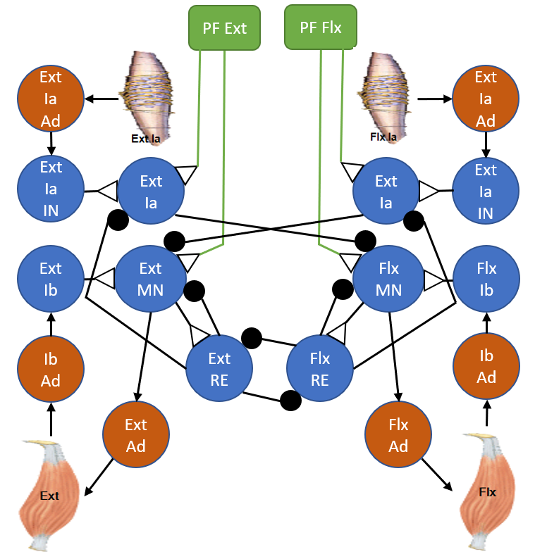
AIM 3 · CLOSING THE LOOP
Four afferent channels close the loop, organized by the Sensory Afferent Database
Ia
muscle length + velocity
stretch reflex; phase-dependent PF modulation
Ib
muscle force
load-dependent regulation of stance extensor activity
II
muscle length
position sense; interjoint coordination
heel / toe
contact
discrete stance-swing boundaries; phase transitions
sensorimotor organization: MN, IN, Ia / Ib pathways
Sensory Afferent Database: Bolen 2023; AI-assisted expansion: Bolen 2024
30
Notes:
The database (Ben led both papers) is what makes the gain choices literature-grounded rather than arbitrary.

Slide 31
AIM 3 · VERIFICATION-FIRST
Verify each circuit against tonic-stimulation physiology before any gait tuning
rhythm generator
tonic stim → locomotor rhythm
VERIFY
sign
gain
phase
then - and only then - tune walking speed
pattern-formation layer
tonic stim → phase-appropriate activation
motoneuron pools
tonic stim → force / activation
stimulate each level; compare with literature
air-stepping analogue: Selionov 2009; deletion/stimulation: Rybak 2006; Markin 2010
31
Notes:
Methodological discipline slide: no walking-speed tuning until sign, gain, and phase structure replicate the literature at each level.

Slide 32
AIM 3 · PHYSICAL REALIZATION
The destination: embedded neural control on a treadmill biped
Teensy per-joint loops
valve control, pressure + contact sensing (hard real-time)
Jetson-class companion
SNS network evaluation → activations
Dissertation maps on board
F(l₀, P, ε) and χ-corrected torque as feedforward / lookup
Contraction lever
reverse-pulley block-and-tackle: force for travel where routes run long
AARL BPA quadruped: SNS control, treadmill hardware
aspiration: dynamic whole-body maneuvers - a kickflip exercises every layer
quadruped precedent: Lutz 2025 (MuJoCo-SNS co-sim → hardware); stack: Teensy + Jetson (SNS-Toolbox backend)
32
Notes:
The division of labor: Teensy = hard real-time per-joint; Jetson = network evaluation. Static maps of this dissertation = feedforward lookup; Elzein model = pulse-modulated pressure dynamics.

Slide 33
SYNTHESIS
Three contributions, one validated design chain
ACTUATOR
CORRECTIONS
JOINT
CONTROLLER - NEXT
F(l₀, P, ε)
χ₀ χ₁ χ₂ χ₃
meets / exceeds human
RG + PF spinal network
537 tests · dimensionless surface
adj. R² > 0.99 in validation
identified on pinned knee,
one stiffness pair across configs
beats baseline in every pool test
biomimetic knee vs Gait2392 torque
over most of range of motion
rhythm verified in isolation;
feedback tuning = critical path
Each stage feeds the next: force model → torque model → plant for controller design → validated architecture for the robot.
Dissertation Ch. 2-6
33
Notes:
Each stage feeds the next. The committee read these numbers; this is the one-slide summary.

Slide 34
HONEST BOUNDARIES
What these results do not claim
Isometric only
no dynamics: hysteresis, airflow, damping; dynamic characterization is future work
ε₆₂₀ not predictable a priori
record max contraction per individual muscle; variance across muscles is real
Stiffness pair not unique
the pinned-flexor data admit a family; one consistent pair adopted, ties broken cross-configuration
Bio-extensor variance
FVU 2.35 > 1: improvement over baseline is real, validated prediction is not claimed
Static map
manufacturing tolerance ±10%; aging and lifecycle behavior unmeasured
Dissertation Ch. 5 (Discussion)
34
Notes:
Pre-empt the committee's sharpest questions by stating them first.

Slide 35
FUTURE WORK
From here: two-muscle tests now, treadmill biped next
NOW
DYNAMICS
CLOSED LOOP
SENSORIUM
HARDWARE
2-BPA flexor tests;
surrogateopt revisit
isokinetic / isobaric /
isotonic + Elzein model
RG oscillation tuning →
co-sim → tonic-stim verification
vestibular (IMU) · ocular drift
correction · cerebellar gating
treadmill biped:
Teensy + Jetson + SNS
Long-term: dynamic whole-body maneuvers - the kickflip aspiration.
A robot whose nervous system - unlike a living animal's - can be instrumented, stimulated, and lesioned at will.
Dissertation Ch. 6
35
Notes:
In progress NOW: two-BPA parallel flexor tests + surrogateopt revisit. Then dynamic characterization, closed-loop co-sim, sensorium extensions, hardware.

Slide 36
Acknowledgments
ADVISOR
M. Anthony Hunt
COMMITTEE
thank you for reading, commenting, and being here
COLLABORATORS
M. Elzein · L. Pang · L. Burgess · C. Morrow · J. Scharzenberger · C. Steele · J. Chung
LAB & SUPPORT
Agile & Adaptive Robotics Laboratory · Portland State University · NeuroNex community
36
Notes:
Keep brief; thank by name.

Slide 37
Thank you - questions?
Movement and Control of Biomimetic Humanoid Robots
Ben P. Bolen · bbolen83@gmail.com
Appendix: model details, protocol, robustness checks
Notes:
Anticipated questions route to the appendix: uniqueness of stiffness pair (G), bracket point (H), frame conventions (G), wrap-loss implementation (E).

Slide 38
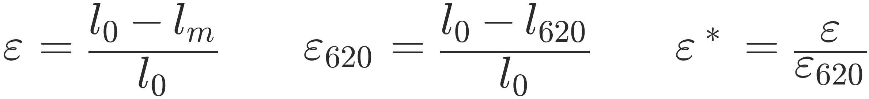
APPENDIX A · MODEL
The complete actuator force model
STRAIN MEASURES
NORMALIZED SURFACE
MAXIMUM FORCE (GENERAL P)
ISOMETRIC FORCE
Dissertation Eqs. 3.1-3.5; implementation: Functions/f_festo.m, maxBPAforce.m
38
Notes:
One-look reference card.

Slide 39
APPENDIX B · COEFFICIENTS
Coefficient values with 95% confidence intervals
F₆₂₀ arctan fits
b₁ (N)
b₂ (1/m)
adj. R²
RMSE (N)
ALSO ON RECORD
F₆₂₀ arctan fits: RMSE vs the FESTO TOOL: 189.9 N (10 mm), 668.4 N (20 mm) - the tool cannot track resting length.
A 40 mm fit exists in code (c₀ 0.1224, c₁ 10.47, c₂ 2.023) but is unused in the dissertation.
φ10 mm
303.5 (300, 308)
19.03 (17.5, 20.6)
0.9854
14.7
φ20 mm
922.4 (914, 931)
15.37 (14.8, 16.0)
0.9945
23.8
F* surface coefficients
c₀
c₁
c₂
R² fit / val.
φ10 mm
0.5682
4.254
0.5597
0.9998 / 0.9994
φ20 mm
0.2579
6.477
1.321
0.992 / 0.9943
Bolen et al. 2026, Actuators, Tables 1-2
39
Notes:
Tight CIs relative to coefficient magnitudes; fitted with fittype NLLS + LAR robustness, lower bounds [0,0,0].

Slide 40
APPENDIX C · COMPARISON
Full goodness-of-fit against published BPA models
Bolen RMSE
FVU
max
Sárosi RMSE
FVU
max
M&B RMSE
FVU
max
10 mm, 257 mm
22.9
0.04
46.0
143.8
1.39
235.8
73.8
0.37
122.9
10 mm, 233 mm
16.8
0.02
30.3
132.7
1.17
222.6
62.6
0.26
101.2
20 mm, 300 mm
35.6
0.01
114.0
132.1
0.20
313.4
72.8
0.06
137.8
20 mm, 450 mm
67.6
0.03
166.6
177.7
0.18
294.8
862.1
4.20
1321.1
Takeaway: fixed-parameter models fail when moved off their fit length;
the normalized fit holds across lengths because each muscle carries its own F₆₂₀ and ε₆₂₀.
Bolen et al. 2026, Actuators, Table 3; RMSE / max error in N; FVU = fraction of variance unexplained
40
Notes:
Sarosi params exist per length; Martens-Boblan is geometry-sensitive - note the negative-force failure at 450 mm.

Slide 41
APPENDIX D · COMPLIANCE CHAIN
From bracket stiffness matrix to solved deflection
1 · project compliance on the force direction
2 · add artificial tendon in series
3 · solve the force balance, then propagate
δ from F₆₂₀·F*(ε*(δ), P*) − kₑₔ·δ = 0 (fzero, bracket [0, lₘ − l₆₂₀]; δ ≡ 0 if uncorrected ε* > 1)
then vector deflection → attachment moves → path length, force direction, moment arm, torque recomputed
two-BPA flexor grouping: coupled balance shares one common force, solved on [0, F₆₂₀]
Dissertation App. A §A.3; minimizeFlxPin2brk.m / MonoPam_mult.m
41
Notes:
For the controls professor: this is a one-dimensional nonlinear root-find per configuration, solved by fzero on a bracketed interval.

Slide 42
APPENDIX E · WRAP LOSS
Wrapping-loss implementation, per contact arc
PINNED EXTENSOR
two physical contact arcs:
R₁ = 12 mm from 27° to −23°
R₂ = 40 mm on the second bracket
arc-length normalizers: 27.75/(ang₁−ang₂), 92.46/(ang₂+120°)
BIOMIMETIC CONFIGURATIONS
Δl = χ₃ · b(θₖ) · (1 − ε*)²
b(θₖ) = routed bend measure (arc length swept by the wrap)
w Rap = 25 mm bend radius in the route builder
Applied to the force-producing strain only
the kinematic strain that predicts muscle length excludes Δl - the loss changes force, not recorded geometry.
minimizeExtX3.m (Contraction, lines 327-370); MonoPamDataExplicit_balanceX3.m
42
Notes:
The loss enters only the FORCE-PRODUCING strain; the kinematic (prediction) strain excludes it - worth stating if asked about double-counting.

Slide 43
APPENDIX F · PROTOCOL
Identification campaign details and data decisions
Encoder correction
the 47 cm flexor test's encoder read ≈5.3° low; +5.3° applied to experimental angles only (phiD untouched), at build time
Training / validation
flexor: 4 train, 47 cm pure hold-out · extensor: six-test pool, tests 3/4/9 excluded a priori
Fold-structure check
every fold lands on the same score plateau; pooled fronts ≈80% cross-fold duplicates - fold choice does not change conclusions
Reproducibility
re-running the extensor CV with a fresh GA seed reproduced the same 4-member front exactly
minimizeFlxPin10mm_2brk.m; Collect_ExtPinX3_sweep.m; Dig_foldLeverage.m
43
Notes:
Two data rulings Ben made: 47 cm encoder fix, and the excluded extensor tests 3/4/9. Fold study: all folds land on the same score plateau.

Slide 44
APPENDIX G · INVARIANCE
Frame convention is irrelevant for y-symmetric stiffness arrays
CLAIM
Let K = diag(a, b, a) - equal stiffness about x and z. For any frame whose second rotation is about y, the projected scalar stiffness
k(û) = (ûᵀ K⁻¹ û)⁻¹
is unchanged: a rotation about y mixes only the two coordinates with equal compliance 1/a, and ûᵀ K⁻¹ û is invariant under orthogonal transforms within that eigenspace.
Verified: two-rotation vs one-rotation implementations agree to ≈1×10⁻¹⁷.
SCOPE
Holds for y-symmetric arrays only (Kₓ = Kᶣ).
The extensor's arch bracket uses K = diag(χ₂, χ₁, χ₂)-type orderings that are NOT symmetric; those axis assignments are a modeling choice carried on physical grounds (buckling argument), not derived from this proof.
proven numerically 2026-09-08: 1-rotation vs 2-rotation frames agree to ~1e-17
44
Notes:
For the math professor: the compliance scalar is invariant because the second rotation is about the symmetry axis of K.

Slide 45
APPENDIX H · ROBUSTNESS
Extensor identification is robust to the bracket reference point
rib midpoint (adopted)
lower bolt hole
bracket point
[-3.84, -46.44, 62.5] mm
[-6.26, -29.69, 75.06] mm
pick χ₃
0.62
0.60
pick χ₀
−10.1 mm
−11.6 mm
bio-ext RMSE / FVU / max
2.195 / 2.35 / 4.73
2.204 / 2.369 / 4.727
filter pass
72 / 90
83 / 90
Conclusion: the extensor χ identification does not hinge on where the bracket point is placed.
minimizeExtX3.m Pbr variants, 1trans CVs; both fronts captured
45
Notes:
Rib midpoint (adopted) vs lower bolt hole - essentially identical outcomes, so the choice does not drive the answer.

Slide 46
APPENDIX I · KINEMATICS
Moment arm and torque conventions
CONVENTIONS
r = perpendicular foot of the joint origin onto the line of action; identical result to the cross-product projection of Eq. 3.6
scalar moment arm rₖ = hypot(in-plane components) in the tibial body frame, about the knee z-axis
torque evaluated only in tension (entries discarded for ε < −0.02)
coupled pathpoints stay equality-constrained (not welded) so moment arms keep their full range
Young 2019 (analyzing moment arms); MonoPamDataExplicit.m lines 156-168
46
Notes:
Scalar arm is in the tibial frame about z; compressive values discarded at eps < -0.02.

Slide 47
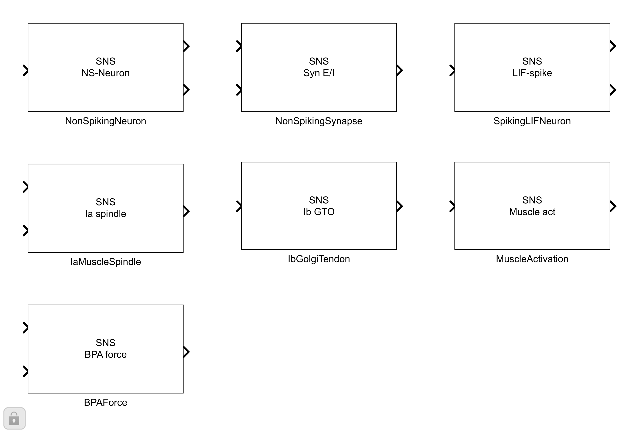
APPENDIX J · IMPLEMENTATION
Synthetic nervous system: library blocks and reflex topology
seven masked blocks; E/I icons auto-draw from synapse sign
reduced-order knee reflex: Ia/Ib, antagonist MNs, Renshaw-style recursion
CAD route settled: SolidWorks → URDF → smimport (verified); tendon parts modeled, insertion pending
Simulink SNS library + KneeReflexDemo; AnimatLab neuron params: App. B of the dissertation
47
Notes:
Two parallel implementations: AnimatLab (bipedal prototyping) and Simulink/MuJoCo (pipeline). The 7-block library runs in base Simulink.

